Slide 1
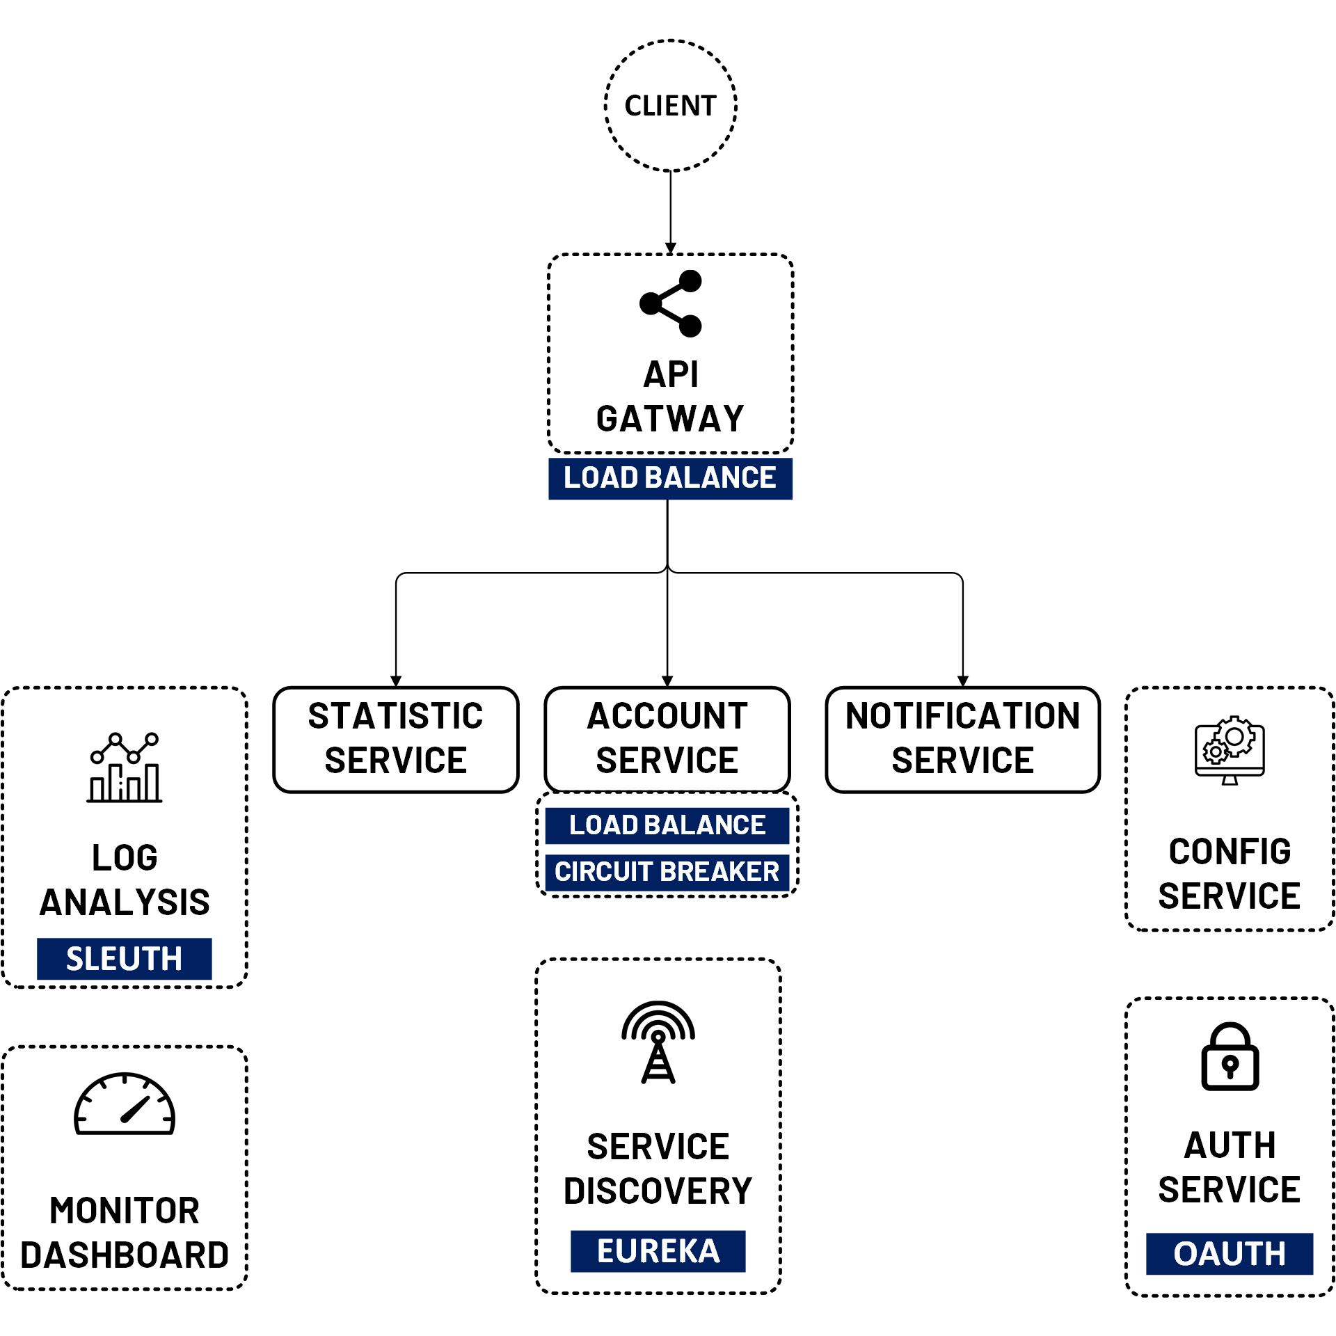

Micro Service Summary
Port:
9080, 9081
Port: 9082
Port: 9083
www.jmaster.io/course/microservices-with-spring-cloud

